Slide 1
Professional Ethics in Software Engineering

Slide 2

Topics covered
Professional ethics
ACM / IEEE Software Engineering Code of Ethics and Professional Practice
Case studies

Slide 3

Professional Ethics
What does it take to be a computing professional?
Professional certification:
IEEE
CIPS
Industry certification
Microsoft
Cisco
University degree / diploma
Mothers basement
No formal educational requirements required in Canada, or most countries actually to call yourself a computing professional

Slide 4
Professional certification
IEEE
Institute of Electrical and Electronics Engineers
enhance professional credibility;
increase opportunities for career advancement;
set you apart from your peers;
demonstrate commitment to the profession;
result in greater respect from employers;
increased confidence on the job.
https://www.ieee.org/index.html
CIPS
Canada’s Association of IT Professionals
http://www.cips.ca/

Slide 5
Industry certification
Microsoft
Microsoft Certified Professional (MCP)
Validates IT professional and developer technical expertise through rigorous, industry-proven, and industry-recognized exams.
MCP exams cover a wide range of Microsoft products, technologies, and solutions
Cisco
Network Administrator
Many other third party industry certification programs

Slide 6
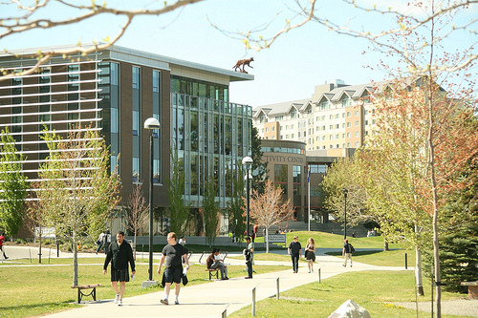
University Education
Degree
Theoretical (long term and foundational items)
Practical (short term specific technologies)
Diploma
Practical (short term specific technologies)

Slide 7
Mothers basement
How many SW professionals are self taught?
Estimates that only about ½ of software developers have a credential related to what they are doing
Many individuals working in the computing industry call themselves software professionals but are not trained in the field
In most processional fields you cannot call yourself a professional in a field with out training and certification of some type
This has a big effect on the perceived professionalism of the field

Slide 8
ACM/IEEE-CS: Software Engineering Code of Ethics and Professional Practice taken from the site:
https://www.acm.org/about/se-code#full

Slide 9
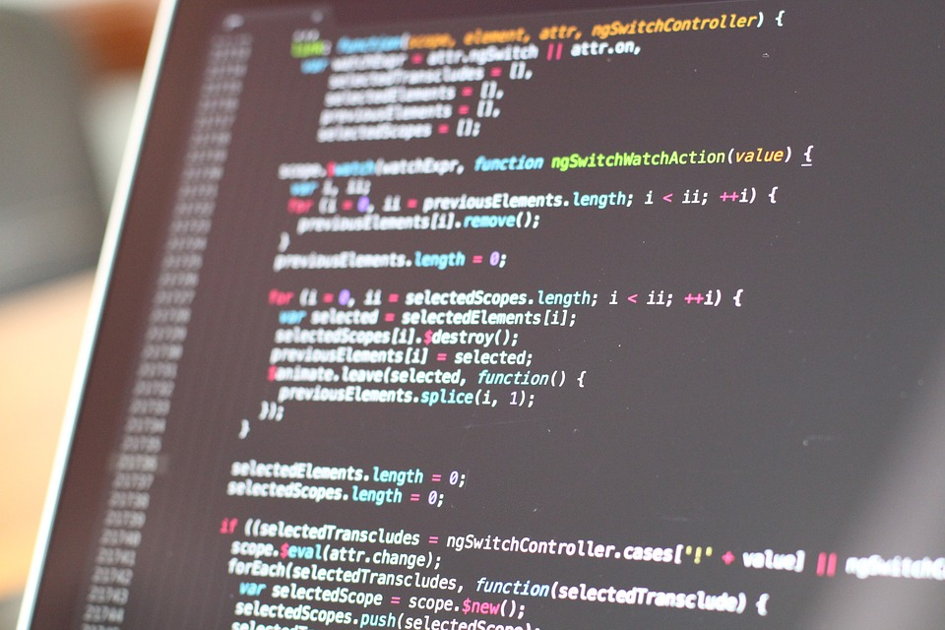
Preamble
Computers have a central and growing role in
commerce,
industry,
government,
medicine,
education,
entertainment and
society at large.
Software engineers are those who contribute by direct participation or by teaching, to the analysis, specification, design, development, certification, maintenance and testing of software systems.

Slide 10

Preamble
Because of their roles in developing software systems, software engineers have significant opportunities to do good or cause harm, to enable others to do good or cause harm, or to influence others to do good or cause harm.
To ensure, as much as possible, that their efforts will be used for good, software engineers must commit themselves to making software engineering a beneficial and respected profession.
In accordance with that commitment, software engineers shall adhere to the following Code of Ethics and Professional Practice.

Slide 11

Preamble Cont.
The Code contains eight Principles related to the behavior of and decisions made by professional software engineers, including
practitioners
managers
policy makers
educators
supervisors
trainees
students of the profession

Slide 12

Preamble Cont.
The Principles identify the ethically responsible relationships in which individuals, groups, and organizations participate and the primary obligations within these relationships.
The Clauses of each Principle are illustrations of some of the obligations included in these relationships.
These obligations are founded in the software engineer’s humanity, in special care owed to people affected by the work of software engineers, and the unique elements of the practice of software engineering.
The Code prescribes these as obligations of anyone claiming to be or aspiring to be a software engineer.

Slide 13

Preamble Cont.
It is not intended that the individual parts of the Code be used in isolation to justify errors of omission or commission.
The list of Principles and Clauses is not exhaustive.
The Clauses should not be read as separating the acceptable from the unacceptable in professional conduct in all practical situations.
The Code is not a simple ethical algorithm that generates ethical decisions. In some situations standards may be in tension with each other or with standards from other sources.
These situations require the software engineer to use ethical judgment to act in a manner which is most consistent with the spirit of the Code of Ethics and Professional Practice, given the circumstances.

Slide 14

Preamble Cont.
Ethical tensions can best be addressed by thoughtful consideration of fundamental principles, rather than blind reliance on detailed regulations.
These Principles should influence software engineers
to consider broadly who is affected by their work;
to examine if they and their colleagues are treating other human beings with due respect;
to consider how the public, if reasonably well informed, would view their decisions;
to analyze how the least empowered will be affected by their decisions;
and to consider whether their acts would be judged worthy of the ideal professional working as a software engineer.
In all these judgments concern for the health, safety and welfare of the public is primary; that is, the "Public Interest" is central to this Code.

Slide 15

Preamble Cont.
The dynamic and demanding context of software engineering requires a code that is adaptable and relevant to new situations as they occur.
However, even in this generality, the Code provides support for software engineers and managers of software engineers who need to take positive action in a specific case by documenting the ethical stance of the profession.
The Code provides an ethical foundation to which individuals within teams and the team as a whole can appeal.
The Code helps to define those actions that are ethically improper to request of a software engineer or teams of software engineers.

Slide 16
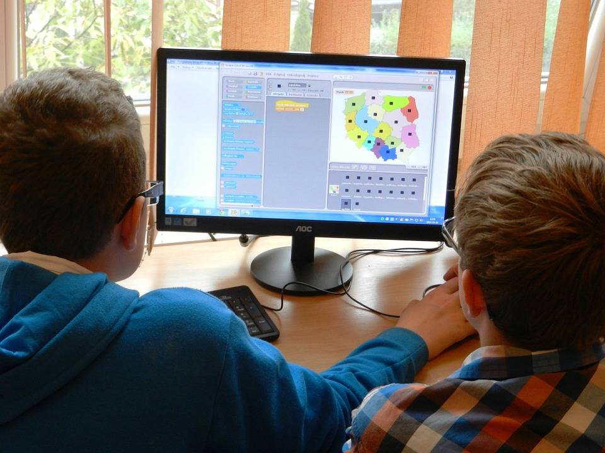
Preamble Cont.
The Code is not simply for adjudicating the nature of questionable acts; it also has an important educational function.
As this Code expresses the consensus of the profession on ethical issues, it is a means to educate both the public and aspiring professionals about the ethical obligations of all software engineers.

Slide 17
PRINCIPLES
The ACM/IEEE Software Engineering Code of Ethics and Professional Practice is broken down into 8 principles that must be followed.
Software Engineering Code of Ethics and Professional Practice
PUBLIC
CLIENT AND EMPLOYER
PRODUCT
JUDGMENT
MANAGEMENT
SELF
PROFESSION
COLLEAGUES

Slide 18
Principle 1: PUBLIC
Software engineers shall act consistently with the public interest. In particular, software engineers shall, as appropriate:
Accept full responsibility for their own work. Moderate the interests of the software engineer, the employer, the client and the users with the public good. Approve software only if they have a well-founded belief that it is safe, meets specifications, passes appropriate tests, and does not diminish quality of life, diminish privacy or harm the environment. The ultimate effect of the work should be to the public good. Disclose to appropriate persons or authorities any actual or potential danger to the user, the public, or the environment, that they reasonably believe to be associated with software or related documents. Cooperate in efforts to address matters of grave public concern caused by software, its installation, maintenance, support or documentation. Be fair and avoid deception in all statements, particularly public ones, concerning software or related documents, methods and tools. Consider issues of physical disabilities, allocation of resources, economic disadvantage and other factors that can diminish access to the benefits of software. Be encouraged to volunteer professional skills to good causes and contribute to public education concerning the discipline.

Slide 19
Principle 2: CLIENT AND EMPLOYER
Software engineers shall act in a manner that is in the best interests of their client and employer, consistent with the public interest. In particular, software engineers shall, as appropriate:
Provide service in their areas of competence, being honest and forthright about any limitations of their experience and education. Not knowingly use software that is obtained or retained either illegally or unethically. Use the property of a client or employer only in ways properly authorized, and with the client's or employer's knowledge and consent. Ensure that any document upon which they rely has been approved, when required, by someone authorized to approve it. Keep private any confidential information gained in their professional work, where such confidentiality is consistent with the public interest and consistent with the law. Identify, document, collect evidence and report to the client or the employer promptly if, in their opinion, a project is likely to fail, to prove too expensive, to violate intellectual property law, or otherwise to be problematic. Identify, document, and report significant issues of social concern, of which they are aware, in software or related documents, to the employer or the client. Accept no outside work detrimental to the work they perform for their primary employer. Promote no interest adverse to their employer or client, unless a higher ethical concern is being compromised; in that case, inform the employer or another appropriate authority of the ethical concern.

Slide 20
Principle 3: PRODUCT
Software engineers shall ensure that their products and related modifications meet the highest professional standards possible. In particular, software engineers shall, as appropriate:
Strive for high quality, acceptable cost and a reasonable schedule, ensuring significant tradeoffs are clear to and accepted by the employer and the client, and are available for consideration by the user and the public. Ensure proper and achievable goals and objectives for any project on which they work or propose. Identify, define and address ethical, economic, cultural, legal and environmental issues related to work projects. Ensure that they are qualified for any project on which they work or propose to work by an appropriate combination of education and training, and experience. Ensure an appropriate method is used for any project on which they work or propose to work. Work to follow professional standards, when available, that are most appropriate for the task at hand, departing from these only when ethically or technically justified.

Slide 21
Principle 3: PRODUCT cont.
Strive to fully understand the specifications for software on which they work. Ensure that specifications for software on which they work have been well documented, satisfy the users’ requirements and have the appropriate approvals. Ensure realistic quantitative estimates of cost, scheduling, personnel, quality and outcomes on any project on which they work or propose to work and provide an uncertainty assessment of these estimates. Ensure adequate testing, debugging, and review of software and related documents on which they work. Ensure adequate documentation, including significant problems discovered and solutions adopted, for any project on which they work. Work to develop software and related documents that respect the privacy of those who will be affected by that software. Be careful to use only accurate data derived by ethical and lawful means, and use it only in ways properly authorized. Maintain the integrity of data, being sensitive to outdated or flawed occurrences. Treat all forms of software maintenance with the same professionalism as new development.

Slide 22
Principle 4: JUDGMENT
Software engineers shall maintain integrity and independence in their professional judgment. In particular, software engineers shall, as appropriate:
Temper all technical judgments by the need to support and maintain human values. Only endorse documents either prepared under their supervision or within their areas of competence and with which they are in agreement. Maintain professional objectivity with respect to any software or related documents they are asked to evaluate. Not engage in deceptive financial practices such as bribery, double billing, or other improper financial practices. Disclose to all concerned parties those conflicts of interest that cannot reasonably be avoided or escaped. Refuse to participate, as members or advisors, in a private, governmental or professional body concerned with software related issues, in which they, their employers or their clients have undisclosed potential conflicts of interest.

Slide 23
Principle 5: MANAGEMENT
Software engineering managers and leaders shall subscribe to and promote an ethical approach to the management of software development and maintenance . In particular, those managing or leading software engineers shall, as appropriate:
Ensure good management for any project on which they work, including effective procedures for promotion of quality and reduction of risk. Ensure that software engineers are informed of standards before being held to them. Ensure that software engineers know the employer's policies and procedures for protecting passwords, files and information that is confidential to the employer or confidential to others. Assign work only after taking into account appropriate contributions of education and experience tempered with a desire to further that education and experience.

Slide 24
Principle 5: MANAGEMENT
Ensure realistic quantitative estimates of cost, scheduling, personnel, quality and outcomes on any project on which they work or propose to work, and provide an uncertainty assessment of these estimates. Attract potential software engineers only by full and accurate description of the conditions of employment. Offer fair and just remuneration. Not unjustly prevent someone from taking a position for which that person is suitably qualified. Ensure that there is a fair agreement concerning ownership of any software, processes, research, writing, or other intellectual property to which a software engineer has contributed. Provide for due process in hearing charges of violation of an employer's policy or of this Code. Not ask a software engineer to do anything inconsistent with this Code. Not punish anyone for expressing ethical concerns about a project.

Slide 25
Principle 6: PROFESSION
Software engineers shall advance the integrity and reputation of the profession consistent with the public interest. In particular, software engineers shall, as appropriate:
Help develop an organizational environment favorable to acting ethically. Promote public knowledge of software engineering. Extend software engineering knowledge by appropriate participation in professional organizations, meetings and publications. Support, as members of a profession, other software engineers striving to follow this Code. Not promote their own interest at the expense of the profession, client or employer. Obey all laws governing their work, unless, in exceptional circumstances, such compliance is inconsistent with the public interest.

Slide 26
Principle 6: PROFESSION cont.
Be accurate in stating the characteristics of software on which they work, avoiding not only false claims but also claims that might reasonably be supposed to be speculative, vacuous, deceptive, misleading, or doubtful. Take responsibility for detecting, correcting, and reporting errors in software and associated documents on which they work. Ensure that clients, employers, and supervisors know of the software engineer's commitment to this Code of ethics, and the subsequent ramifications of such commitment. Avoid associations with businesses and organizations which are in conflict with this code. Recognize that violations of this Code are inconsistent with being a professional software engineer. Express concerns to the people involved when significant violations of this Code are detected unless this is impossible, counter-productive, or dangerous. Report significant violations of this Code to appropriate authorities when it is clear that consultation with people involved in these significant violations is impossible, counter-productive or dangerous.

Slide 27
Principle 7: COLLEAGUES
Software engineers shall be fair to and supportive of their colleagues. In particular, software engineers shall, as appropriate:
Encourage colleagues to adhere to this Code. Assist colleagues in professional development. Credit fully the work of others and refrain from taking undue credit. Review the work of others in an objective, candid, and properly-documented way. Give a fair hearing to the opinions, concerns, or complaints of a colleague. Assist colleagues in being fully aware of current standard work practices including policies and procedures for protecting passwords, files and other confidential information, and security measures in general. Not unfairly intervene in the career of any colleague; however, concern for the employer, the client or public interest may compel software engineers, in good faith, to question the competence of a colleague. In situations outside of their own areas of competence, call upon the opinions of other professionals who have competence in that area.

Slide 28
Principle 8: SELF
Software engineers shall participate in lifelong learning regarding the practice of their profession and shall promote an ethical approach to the practice of the profession. In particular, software engineers shall continually endeavor to:
Further their knowledge of developments in the analysis, specification, design, development, maintenance and testing of software and related documents, together with the management of the development process. Improve their ability to create safe, reliable, and useful quality software at reasonable cost and within a reasonable time. Improve their ability to produce accurate, informative, and well-written documentation.

Slide 29
Principle 8: SELF cont.
Improve their understanding of the software and related documents on which they work and of the environment in which they will be used. Improve their knowledge of relevant standards and the law governing the software and related documents on which they work. Improve their knowledge of this Code, its interpretation, and its application to their work. Not give unfair treatment to anyone because of any irrelevant prejudices. Not influence others to undertake any action that involves a breach of this Code. Recognize that personal violations of this Code are inconsistent with being a professional software engineer.

Slide 30
Case Studies
University of Puerto Rico
Centre for Ethics in the Professions
Two brief, older and relatively simple computer ethical cases
http://www.uprm.edu/etica/cpucases.html
Computer Ethics Cases
The Case of the troubled Computer Programmer
Hooked on Electronic Services

Slide 31
Case Studies
Computing Cases Org
A series of in-depth, and very complex computer ethical cases
These cases take you through the process of applying a socio-technical analysis to a situation so that you understand the entire system in which a computing system is embedded.
http://computingcases.org/case_materials/case_materials.html
Therac-25
Machado
Hughes Aircraft
Educational Laptop
Biomatrix
Carnivore
Toysmart

